Slide 1
Data Modeling Using the Entity-Relationship (ER) Model
Week 4

Slide 2
Data Modeling Using the Entity-Relationship (ER) Model
Entity-Relationship (ER) model
Popular high-level conceptual data model
Proposed by Peter Chen in 1976
ER diagrams
Diagrammatic notation associated with the ER model
Unified Modeling Language (UML)

Slide 3
Using High-Level Conceptual Data Models for Database Design
Requirements collection and analysis
Database designers interview prospective database users to understand and document data requirements
Result: data requirements
In parallel, also collect functional requirements of the application

Slide 4
Using High-Level Conceptual Data Models (cont’d.)
Conceptual design
Based on description of data requirements, create a conceptual schema using a high-level data model
Includes detailed descriptions of the entity types, relationships, and constraints

Slide 5
Using High-Level Conceptual Data Models (cont’d.)
Logical design or data model mapping
Result is a database schema in implementation data model of DBMS
Physical design phase
Internal storage structures, file organizations, indexes, access paths, and physical design parameters for the database files specified

Slide 6
A Sample Database Application
COMPANY
Employees, departments, and projects
Company is organized into departments
Department controls a number of projects
Employee: store each employee’s name, Social Security number, address, salary, sex (gender), and birth date
Keep track of the dependents of each employee

Slide 7
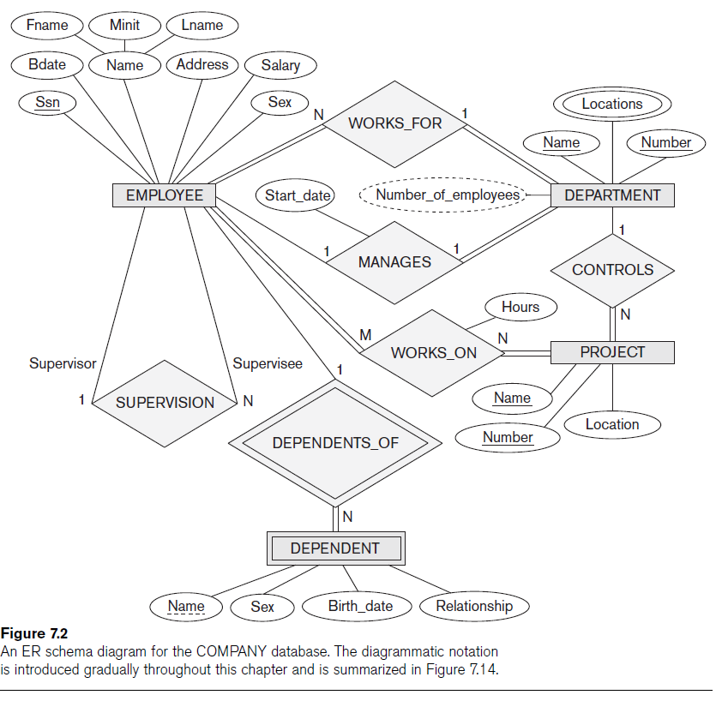

Slide 8
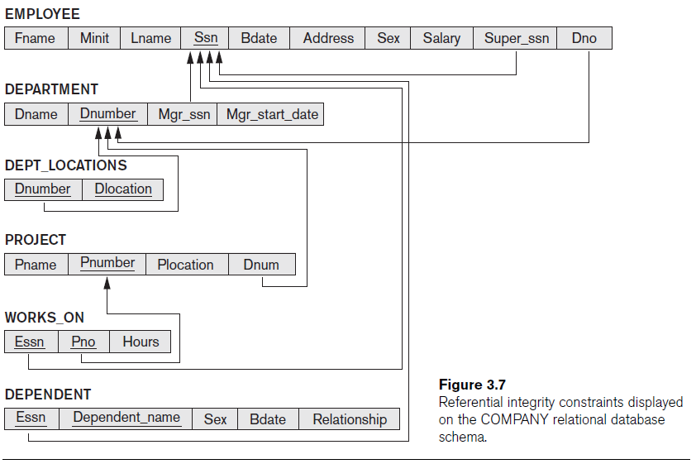
More Complex SQL Retrieval Queries
Additional features allow users to specify more complex retrievals from database:
Nested queries, joined tables, outer joins, aggregate functions, and grouping

Slide 9
Entity Types, Entity Sets, Attributes, and Keys
ER model describes data as:
Entities
Relationships
Attributes

Slide 10
Entities
Things in real world with independent existence
Physical existence: desk, car, stroller
Conceptual existence: degree, job

Slide 11
Attributes
Particular properties that describe entity
Types of attributes:
simple (atomic) vs. composite attributes
Simple: attribute cannot be subdivided into component attributes. Ex: width attribute for a geometric object.
Composite: attribute can be subdivided into component attributes.
Represented with attribute having more attributes branching from itself.
Ex: Address can be subdivided into Street, City, Zip.

Slide 12
Attributes (cont’d)
Types of attributes (cont’d):
Single-valued versus multivalued attributes
Single valued: one value for attribute. Ex: age
Multivalued: attribute can have more than one value.
Represented with double lined attribute shape (ellipse).
Ex: House color could be 2 or more, degrees could be 2 or more, etc.

Slide 13
Attributes (cont’d)
Types of attributes (cont’d):
Stored versus derived attributes
Stored: Ex: StartDate attribute for a job
Derived: NumberOfYearsAtWork attribute can be derived from the StartDate attribute. Some attributes can be derived from related entities: Number of employees of a Department can be derived by counting the number of employees related to (working for) that department.

Slide 14
Attributes (cont’d)
Types of attributes (cont’d):
NULL values
Unknown value
Unavailable or withheld value
Not applicable attribute
Complex attributes

Slide 15
Attributes (cont’d)
Types of attributes (cont’d):
Complex attributes: A nesting of composite and multivalued attributes.
Composite attribute components between () separated by comma
Multivalued attributes between braces {}.
Ex: a person has two residences, each residence having a single address and multiple phones:
{Address_phone( {Phone(Area_code,Phone_number)},
Address(Street_address(Number,Street,Apartment_number),City,State,Zip) )}

Slide 16
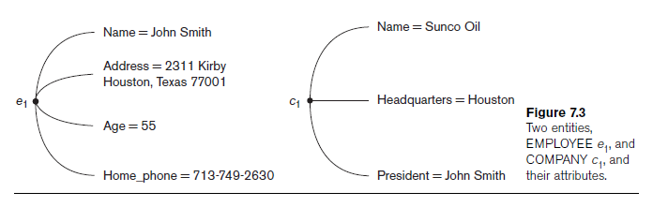
Entities and Attributes (cont’d.)

Slide 17
Entity Type & Entity Set
Entity type
Collection (or set) of entities that have the same attributes
Describes the schema (intension) for a set of entities that share the same structure.
Entity set
Collection of all entities of a particular entity type in the database at any point in time
An extension of the entity type

Slide 18
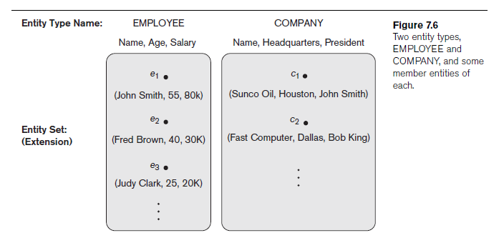
Entity Type & Entity Set

Slide 19
Keys
Key or uniqueness constraint
Attributes whose values are distinct for each individual entity in entity set
Key attribute
Uniqueness property must hold for every entity set of the entity type

Slide 20
Value Sets
Value sets (or domain of values)
Specifies set of values that may be assigned to that attribute for each individual entity
Not displayed in ER diagrams
Mathematically, an attribute A of entity set E whose value set is V is a function from E to the power set P(V) of V:
A: E -> P(V)
where power set is the set of all subsets of V.

Slide 21
COMPANY Database Example - Requirements
The company is organized into departments. Each department has a unique name, a unique number, and a particular employee who manages the department. We keep track of the start date when that employee began managing the department. A department may have several locations.
A department controls a number of projects, each of which has a unique name, a unique number, and a single location.

Slide 22
COMPANY Database Example – Requirements (cont’d)
We store each employee’s name, Social Security number, address, salary, sex (gender), and birth date. An employee is assigned to one department, but may work on several projects, which are not necessarily controlled by the same department. We keep track of the current number of hours per week that an employee works on each project. We also keep track of the direct supervisor of each employee (who is another employee).
We want to keep track of the dependents of each employee for insurance purposes. We keep each dependent’s first name, sex, birth date, and relationship to the employee.

Slide 23
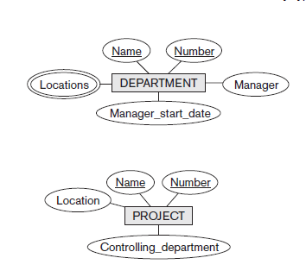
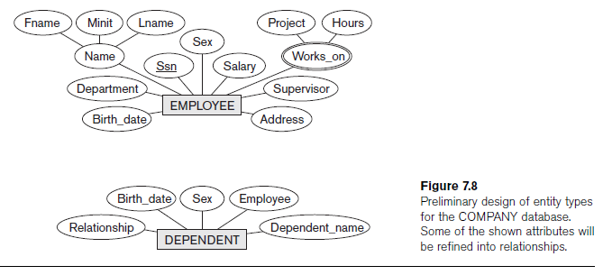
Initial Conceptual Design of the COMPANY Database

Slide 24
Initial Conceptual Design of the COMPANY Database
DEPARTMENT entity:
Attributes: Name, Number, Locations (multivalued attribute!!), Manager, and Manager_start_date.
Both Name and Number are (separate) key attributes as each was specified to be unique.
One will be candidate key, the other PK
Multivalued attribute

Slide 25
Initial Conceptual Design of the COMPANY Database
PROJECT entity type:
Attributes: Name, Number, Location, and Controlling_department.
Both Name and Number are (separate) key attributes.

Slide 26
Initial Conceptual Design of the COMPANY Database
EMPLOYEE entity type:
Attributes Name, Ssn, Sex, Address, Salary, Birth_date, Department, and Supervisor.
Both Name and Address may be composite attributes; but, this was not specified in the requirements.
Composite (and
multivalued)
attribute

Slide 27
Initial Conceptual Design of the COMPANY Database
DEPENDENT entity type:
Attributes: Employee, Dependent_name, Sex, Birth_date, and Relationship (to the employee).

Slide 28
Initial Conceptual Design of the COMPANY Database
Two requirements not met yet:
The fact that an employee can work on several projects
The number of hours per week an employee works on each project. 2 suggestions:
Use a multivalued composite attribute of EMPLOYEE called Works_on with the simple components (Project, Hours).
Use a multivalued composite attribute of PROJECT called Workers with the simple components (Employee, Hours).
We choose this

Slide 29
Relationship Types, Relationship Sets, Roles, and Structural Constraints
Relationship
When an attribute of one entity type refers to another entity type
DEPARTMENT.Manager: Refers to an employee who manages the department
PROJECT.Controlling_department: Refers to the department that controls the project
EMPLOYEE.Supervisor: Refers to another employee who supervises this employee
etc.
Represent references as relationships not attributes
So, we need to refine our initial design

Slide 30
Relationship Types, Sets, and Instances
Relationship type R among n entity types E₁, E₂, ..., E_{n}
Defines a set of associations among entities from these entity types
Relationship instances r_{i}
Each r_{i} associates n individual entities (e₁, e₂, ..., e_{n})
Each entity e_{j} in r_{i} is a member of entity set E_{j}

Slide 31
Relationship Degree
Degree of a relationship type
Number of participating entity types
Unary, binary, ternary
Relationships as attributes
Think of a binary relationship type in terms of attributes

Slide 32
Unary Relationship
Degree of the relationship is 1, i.e. involves 1 entity type
Also called recursive relationship
Same entity type participates more than once in a relationship type in different roles
Must specify role name

Slide 33
Unary Relationship - Example
Example:
A SUBJECT serves as a prerequisite for another SUBJECT
A SUBJECT requires another SUBJECT as a prerequisite
SUBJECT
SERVES AS
REQUIRES
PREREQUISITE

Slide 34
Binary Relationship
Degree of the relationship is 2, i.e. involves 2 different entity types
VISITOR
MUSEUM
VISIT

Slide 35
Ternary Relationship
Degree of the relationship is 3, i.e. involves 3 different entity types
PROFESSOR
TEXTBOOK
RECOMMENDS
COURSE

Slide 36
Role Names
Role names
Signifies role that a participating entity plays in each relationship instance

Slide 37
Constraints on Binary Relationship Types
Cardinality ratio for a binary relationship
Specifies maximum number of relationship instances that entity can participate in
Participation constraint
Specifies whether existence of entity depends on its being related to another entity
Types: total and partial
Cardinality ratio and participation constraint together called the structural constraints of a relationship type.

Slide 38
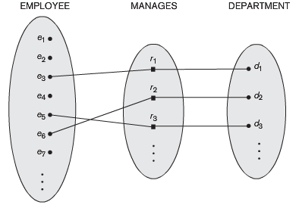
Cardinality Ratio – 1:1
Each entity in the relationship will have exactly 1 related entity
An employee can manage 1 department only, and a department can have 1 manager only.
1
1
EMPLOYEE
MANAGES
DEPARTMENT

Slide 39
Cardinality Ratio – 1:N
An entity on one side of the relationship can have many (N) related entities, but an entity on the other side will have a maximum of 1 related entity.
A project may be associated with at most 1 department. A department may have multiple projects.
N
1
PROJECT
HAS
DEPARTMENT

Slide 40
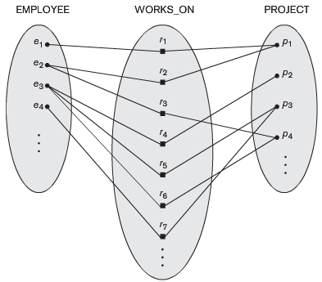
Cardinality Ratio – M:N
Entities on both sides of the relationship can have many (M to N) related entities on the other side.
An employee can work on many projects, and many employees can work on the same project.
M
N
EMPLOYEE
WORKS ON
PROJECT

Slide 41
Cardinality Ratio Examples
PERSON
FACULTY
ASSIGNED
PARKING PLACE
MARRIED TO
CUSTOMER
PLACE
ORDER
STUDENT
ENROLL
COURSE
PATIENT
SEE
DOCTOR
FATHER
HAVE
CHILD

Slide 42
Participation Constraints
Specifies whether the existence of an entity depends on its being related to another entity via the relationship type.
This constraint specifies the minimum number of relationship instances that each entity can participate in, and is sometimes called the minimum cardinality constraint.
2 types:
Total (Mandatory) participation: is also called existence dependency
Partial (Optional) participation

Slide 43
Total (Mandatory) Participation Constraint
In the Employee WORKS_FOR Department relationship: If company policy states that every employee must work for a department, then an employee entity can exist only if it participates in at least one WORKS_FOR relationship instance.
So, the participation of EMPLOYEE in WORKS_FOR is total participation, meaning that every entity in the total set of employee entities must be related to a department entity via WORKS_FOR.

Slide 44
Total (Mandatory) Participation Constraint
In ER diagram, total participation is displayed as a double line connecting the participating entity type to the relationship.
Part of the ER diagram for COMPANY database showing 3 total participation constraints.

Slide 45
Partial (Optional) Participation Constraint
In the Employee MANAGES Department relationship: We do not expect every employee to manage a department, so the participation of Employee in the MANAGES relationship type is partial, meaning that some or part of the set of employee entities are related to some department entity via MANAGES, but not necessarily all.
Still, we expect each Department to be managed, this is why Department has total participation in the MANAGES relationship.
In ER diagram, partial participation is represented by a single line.

Slide 46
Attributes of Relationship Types
Attributes of 1:1 or 1:N relationship types can be migrated to one entity type
The Start_date attribute for the MANAGES relationship can be an attribute of either EMPLOYEE or DEPARTMENT, though conceptually it belongs to MANAGES.
It became an attribute of DEPARTMENT, as seen in the COMPANY database schema diagram.

Slide 47
Attributes of Relationship Types
For a 1:N relationship type, relationship attribute can be migrated only to entity type on N-side of relationship
if the WORKS_FOR relationship also has an attribute Start_date that indicates when an employee started working for a department, this attribute can be included as an attribute of EMPLOYEE.

Slide 48
Attributes of Relationship Types
For M:N relationship types
Some attributes may be determined by combination of participating entities
Must be specified as relationship attributes
The Hours attribute of the M:N relationship WORKS_ON: the number of hours per week an employee currently works on a project is determined by an employee-project combination and not separately by either entity.

Slide 49
Weak Entity Types
Weak entity types do not have key attributes of their own
Identified by being related to specific entities from another entity type
Regular entity types that do have a key attribute are called strong entity types
Identifying relationship
Relates a weak entity type to its owner

Slide 50
Weak Entity Types
Always has a total participation (existence dependency) constraint
Not every total participation is a weak entity.
A DRIVER_LICENCE entity cannot exist unless it is related to a PERSON entity. So, total participation.
Still, DRIVER_LICENCE is NOT a weak entity, b/c it has its own key (License_number).

Slide 51
Weak Entity Types
In the Employee DEPENDENTS_OF Dependent relationship: the attributes of the Dependent relation are Name, Birth_date, Sex, and Relationship (to the employee).
Two dependents of two distinct employees may have the same values for Name, Birth_date, Sex, and Relationship, though they are still distinct entities.
They are identified as distinct entities only after determining the particular Employee entity to which each dependent is related.

Slide 52
Weak Entity Types
A weak entity type normally has a partial key, which is the attribute that can uniquely identify weak entities that are related to the same owner entity. if we assume that no two dependents of the same employee ever have the same first name, the attribute Name of DEPENDENT is the partial key.
In the worst case, a composite attribute of all the weak entity’s attributes will be the partial key.

Slide 53
Weak Entity Types
In ER diagrams, both a weak entity type and its identifying relationship are distinguished by surrounding their boxes and diamonds with double lines
The partial key attribute is underlined with a dashed or dotted line.

Slide 54
Alternative Ways to Represent Weak Entity Types
Weak entity types can be represented as complex (composite, multivalued) attributes.
For Employee relation, specify a multivalued attribute Dependents, which is a composite attribute with component attributes Name, Birth_date, Sex, and Relationship.

Slide 55
Alternative Ways to Represent Weak Entity Types
The choice of which alternative to use is a DB design issue.
Choose the weak entity type representation if there are many attributes.
If the weak entity participates independently in relationship types other than its identifying relationship type, then it should not be modeled as a complex attribute

Slide 56
Refining the ER Design for the COMPANY Database
Change attributes that represent relationships into relationship types
Determine cardinality ratio and participation constraint of each relationship type

Slide 57
Refining the ER Design for the COMPANY Database – Relationship Types
MANAGES
a 1:1 relationship type between EMPLOYEE and DEPARTMENT. EMPLOYEE participation is partial. DEPARTMENT participation is not clear from the requirements. When asked, users say that a department must have a manager at all times, which implies total participation. The attribute Start_date is assigned to this relationship type.
WORKS_FOR
a 1:N relationship type between DEPARTMENT and EMPLOYEE. Both participations are total.

Slide 58
Refining the ER Design for the COMPANY Database – Relationship Types
CONTROLS
a 1:N relationship type between DEPARTMENT and PROJECT. The participation of PROJECT is total, whereas that of DEPARTMENT is determined to be partial, as users indicate that some departments may control no projects.
SUPERVISION
a 1:N relationship type between EMPLOYEE (in the supervisor role) and EMPLOYEE (in the supervisee role). Both participations are determined to be partial, as users indicate that not every employee is a supervisor and not every employee has a supervisor.

Slide 59
Refining the ER Design for the COMPANY Database – Relationship Types
WORKS_ON
an M:N relationship type between EMPLOYEE and PROJECT entity types, with attribute Hours. Created as a result of users indicating that a project can have several employees working on it. Both participations are determined to be total.
DEPENDENTS_OF
a 1:N relationship type between EMPLOYEE and DEPENDENT, which is also the identifying relationship for the weak entity type DEPENDENT. The participation of EMPLOYEE is partial,whereas that of DEPENDENT is total.

Slide 60
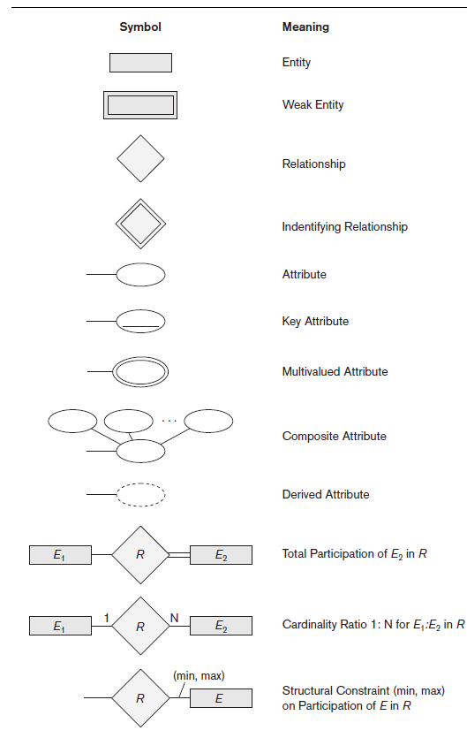
ER Diagrams, Naming Conventions, and Design Issues

Slide 61
Proper Naming of Schema Constructs
Choose names that convey meanings attached to different constructs in schema
Nouns give rise to entity type names
Verbs indicate names of relationship types
Choose binary relationship names to make ER diagram readable from left to right and from top to bottom

Slide 62
Design Choices for ER Conceptual Design
Model concept first as an attribute
Refined into a relationship if attribute is a reference to another entity type
Attribute that exists in several entity types may be elevated to an independent entity type
Can also be applied in the inverse

Slide 63
Alternative Notations for ER Diagrams
(Min, Max) Notation: Specify structural constraints on relationships
Replaces cardinality ratio (1:1, 1:N, M:N) and single/double line notation for participation constraints
Associate a pair of integer numbers (min, max) with each participation of an entity type E in a relationship type R, where 0 ≤ min ≤ max and max ≥ 1

Slide 64
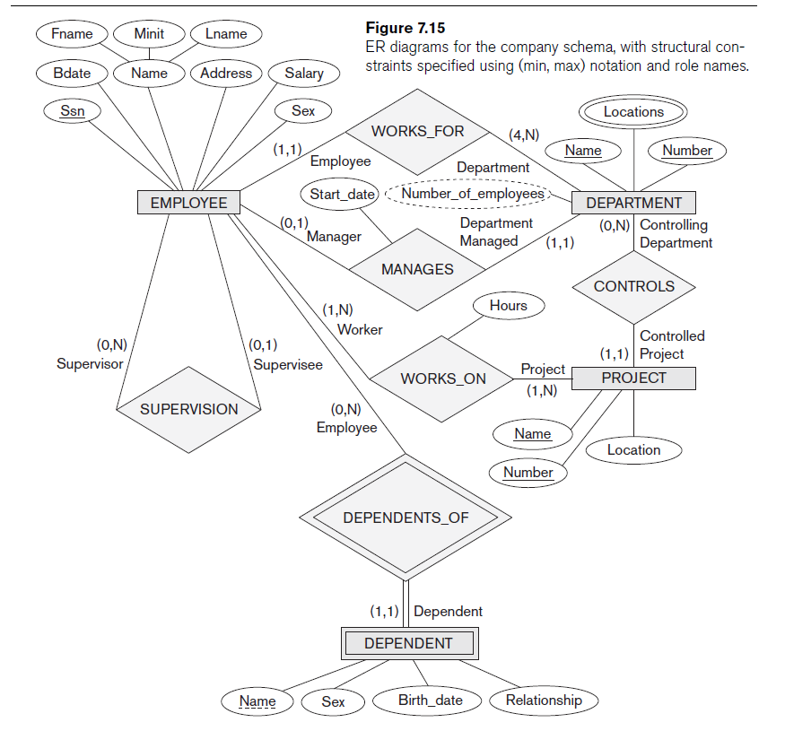
COMPANY Database represented using
(Min, Max) Notation

Slide 65
Example of Other Notation: UML Class Diagrams
UML methodology
Used extensively in software design
Many types of diagrams for various software design purposes
UML class diagrams
Entity in ER corresponds to an object in UML

Slide 66
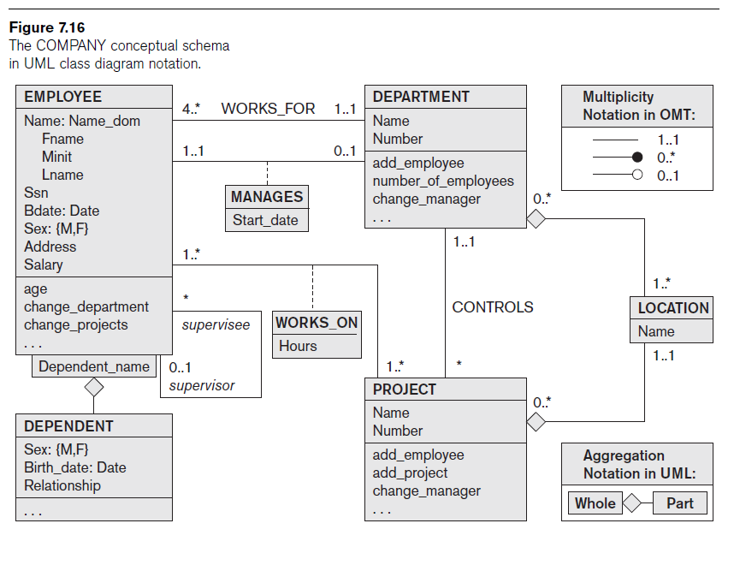

Slide 67
Example of Other Notation: UML Class Diagrams (cont’d.)
Class includes three sections:
Top section gives the class name
Middle section includes the attributes;
Last section includes operations that can be applied to individual objects

Slide 68
Example of Other Notation: UML Class Diagrams (cont’d.)
Associations: relationship types
Relationship instances: links
Binary association
Represented as a line connecting participating classes
May optionally have a name
Link attribute
Placed in a box connected to the association’s line by a dashed line

Slide 69
Example of Other Notation: UML Class Diagrams (cont’d.)
Multiplicities: min..max, asterisk (*) indicates no maximum limit on participation
Types of relationships: association and aggregation
Distinguish between unidirectional and bidirectional associations
Model weak entities using qualified association

Slide 70
Relationship Types of Degree Higher than Two
Degree of a relationship type
Number of participating entity types
Binary
Relationship type of degree two
Ternary
Relationship type of degree three

Slide 71
Choosing between Binary and Ternary (or Higher-Degree) Relationships
Some database design tools permit only binary relationships
Ternary relationship must be represented as a weak entity type
No partial key and three identifying relationships
Represent ternary relationship as a regular entity type
By introducing an artificial or surrogate key

Slide 72
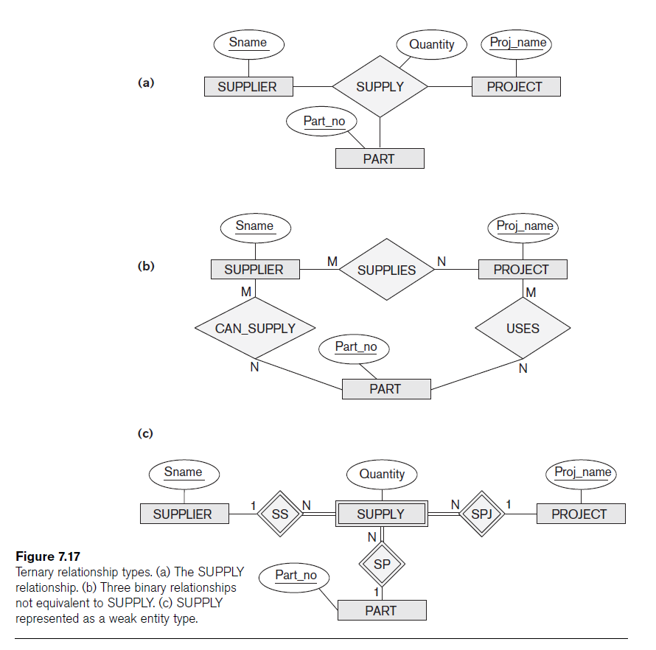

Slide 73
Constraints on Ternary (or Higher-Degree) Relationships
Notations for specifying structural constraints on n-ary relationships
Should both be used if it is important to fully specify structural constraints

